Slide 1
C O U R S E S 2024

Slide 2
ABOUT US
ABOUT N A T H A N
With over 20 years experience in the industry , Nathan has returned to Sheffield
after a long career with arguably the most respected hair brand in the world - Vidal Sassoon London
Nathan's role as a UK creative director has taken him around the world , delivering education and working on editorial projects as well as teaching countless hairdressers
Nathan has maintained his ties to the Sassoon brand in his role as ambassador and here you can experience education that focuses on learning the rules of successful hair cutting in order to expand your repertoire in your own salons .
’As Creative Director of our Leeds, Manchester , Nottingham and Liverpool locations, Nathan was an integral member of the renowned Vidal Sassoon Creative Team, platforming on international and domestic shows and events, teaching at our academy locations as well as making significant contributions to the Vidal Sassoon seasonal collections.
I wish Nathan and his team the very best wishes in their new venture and look forward to continuing our collaboration through our newly introduced Sassoon Ambassador programme, where he will maintain his connection with the Vidal Sassoon team’
Mark Hayes
International creative director
Vidal Sassoon

Slide 3
OUR COURSES
We believe that attending one our cutting courses should empower our students to immediately utilize new skills as soon as they leave our classroom .
For this reason ,we combine theory lectures , demonstrations and practical sessions on live models to build confidence in technique .
A typical day on one of our courses will begin with a lecture to the group, followed by an in depth look and learn demonstration with Nathan. Next up, lunch provided by us followed by an afternoon of creativity , where the learner will gain hands on experience in precision cutting and understanding the effect of lines, layers and graduation on hair and facial features.
On completion of the course , technical drawings from the looks demonstrated and professional images of students work will be issued to the student to showcase and revisit their new found skills .
Notes:
LUNCH
THEORY LECTURES
LIVE MODELS
WORK SESSIONS
DEMONSTRATION
TECHNICAL DRAWINGS TO TAKE AWAY .

Slide 4
2 DAY ABC
MONTH OF MONDAYS
BESPOKE 1-1
2 DAY
PRECISION
FOUNDATION
MONTH OF MONDAYS
CREATIVE
1-1
BESPOKE
TUITION
£340 INCL. VAT
£600 INCL. VAT
£800 INCL. VAT
Notes:
2 DAY ABC
260 X 2 DAYS
MIN 4 = £1040
MAX 8 =£2080
MONTH OF MONDAYS £550
MIN 4 = 2200
MAX 8= 4400
BESPOKE 1-1
£800 PER DAY

Slide 5
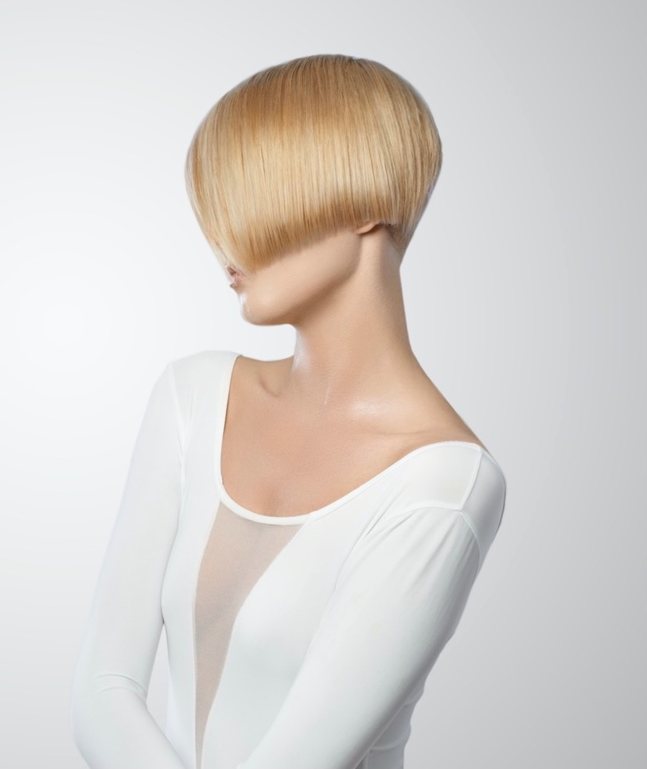
PRECISION FOUNDATION 2 day
This precision cutting course is focused on the core techniques that Nathan mastered and developed in his role at Vidal Sassoon .
Lines ,layers and graduation will be explored in depth, as well as the application of shape and technique combinations . This course sets the foundations for what it means to cut hair with confidence .
M.O.M CREATIVE
4 DAY
The creative course delves into how , once the foundations are understood , limitless possibilities with hair become possible.
In this 4 day course , disconnection ,freehand and reversal of techniques are explored to broaden the students repertoire and understand better how to problem solve with technique.
1-1 BESPOKE TUITION
Bespoke tuition with Nathan can be whatever you would like it to be . Any duration and any course content .
Whether you would like to focus the time on a particular length or technique , or would like to push the boundaries creatively and do something editorial with our in house photographer , we can make this happen for you.

Slide 6
C O U R S E D AT E S
PRECISION 2 DAY
2ND , 3RD JUNE
23RD 24TH^{TH} JUNE
11TH 12TH AUGUST
25TH ,26TH AUGUST
6TH ,7TH OCTOBER
27TH 28TH OCTOBER
MONTH OF MONDAYS
4 DAY
JULY 1^{S} , 8TH,15TH, 22ND
SEPTEMBER 2ND 9TH, 16TH ,23RD
NOVEMBER 4TH 11TH 18TH 25TH
1-1 BESPOKE
CONTACT US FOR AVAILABILTY
For all course enquiries please email us info@nathanrichardsonhair.co.uk or alternatively call 0114 327 0360
Please note: our group courses run on a minimum capacity of 4 participants. Should your booked dates not reach that number , a full refund of your deposit will be given or an alternative date offered.
* We offer a group booking of 10% when booking 3 or more students .

